Slide 1
Marketing Mix Analysis
Tiger Analytics Case Study
AKASH SINGHA
FT251009

Slide 2


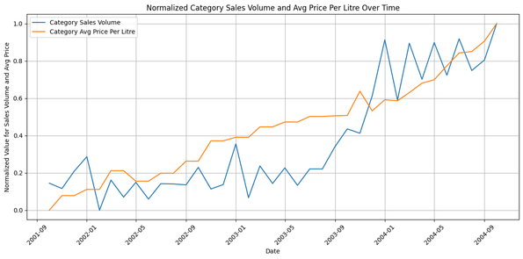
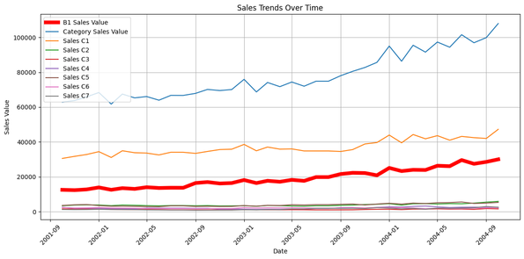

CURRENT STATE:
Over the observed period, both demand and price for the product have shown a positive growth trajectory, reflecting overall industry expansion
The market is primarily led by C1, with B1 as a significant competitor, and together, these two companies dominate the market landscape.
The timeline indicates a rapid growth phase for the product, underscoring strong consumer adoption and industry momentum
Active marketing efforts are limited to only a few players in the market, suggesting that brand visibility and competitive positioning remain largely concentrated among the leading firms.
TARGET STATE:
Capture the expanding market by adopting effective strategic approaches.
Apply an optimized marketing mix to boost market share with minimal expenditure.

Slide 3

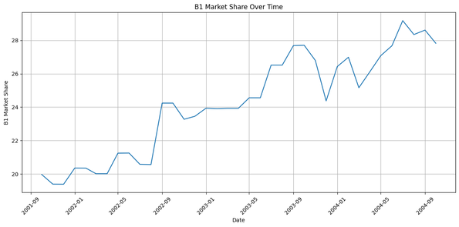
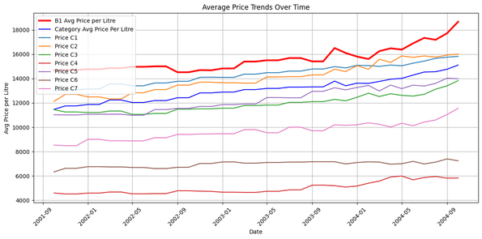
COMPETETIVE SCENARIO
B1’s market share has shown steady growth over time.
Market leader C1 has seen a 4-5% decline in market share over recent years.
Recently, both leading brands have increased investments in TV and non-TV advertising.
For pricing strategy, B1 consistently maintains a premium position, while C1 also prices above the market average, leveraging its extensive reach and brand recognition to capture higher-than-average profits.
C1 holds a significant advantage in Weighted Distribution Value, reflecting strong geographical penetration.

Slide 4
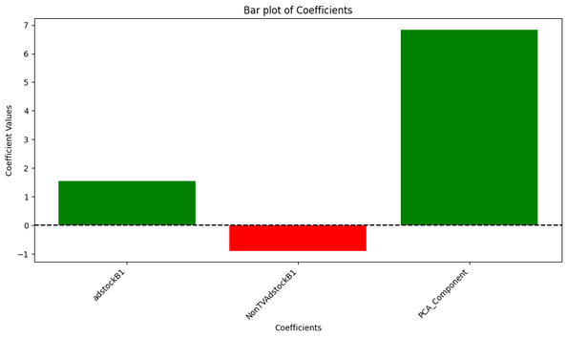
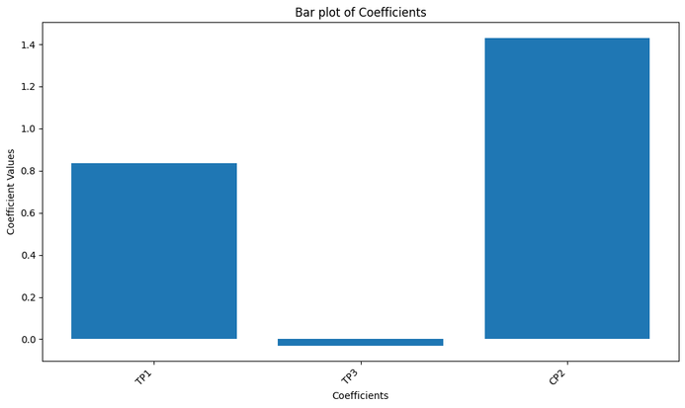
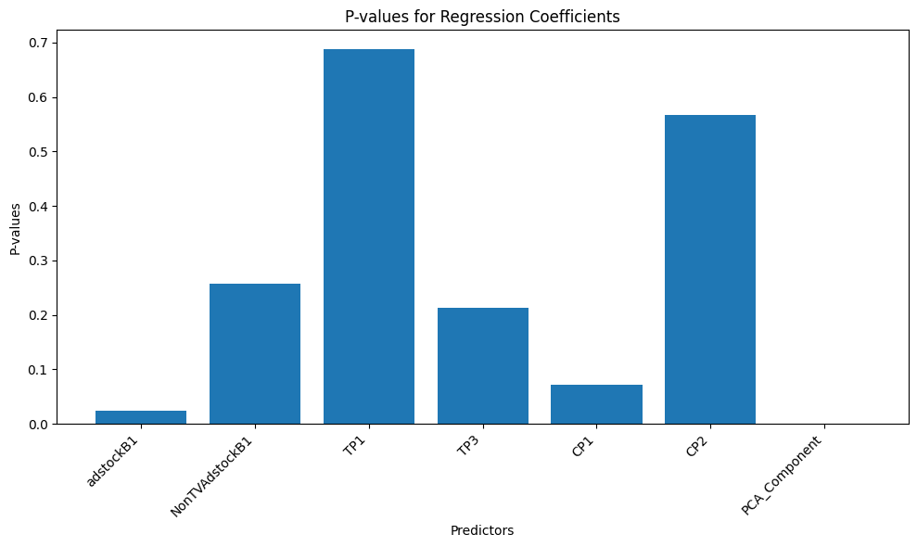
MARKET DRIVERS
The primary driver behind B1's market share growth is the increase in its Weighted Distribution Value.
Expanding the number of dealers contributed significantly to the market share rise.
TV Ad Stock positively influenced B1’s market share growth.
Non-TV advertising had minimal to no effect on B1’s market share increase.
Although trade and sales promotions were insignificant maybe because they are short term and doesn’t affect market heavily in the overall model, although individually Trade Promotion 1 and Customer Promotion 2 shows a positive impact and may exhibit diminishing effects over time due to decay.
ASSUMPTIONS:
Decay Rate for TV advertisement =.9
Decay rate for Non-TV advertisement = .4
PCA Components = Price per Liter + Weighted Value of the Distribution + Number of Dealers

Slide 5






CONTROLLING FACTORS
Geographical Reach: B1 lags behind market leader C1 in geographical penetration. By strategically placing products in more stores, B1 could drive higher sales and returns.
Premium Pricing Strategy: B1’s high pricing supports its premium brand image, which should be leveraged cautiously, as excessive price increases may reduce demand.
Industry Growth: With the industry in its growth phase, B1 has a prime opportunity to capture supernormal profits.
Effective Promotions: Trade Promotion 1 and Customer Promotion 2 appear more impactful for sales growth, though B1 currently allocates more budget to Trade Promotion 2. Increasing investment in Trade Promotion 1 may yield better returns.
TV Advertising: TV advertising demonstrates a stronger influence on sales compared to non-TV promotions.
Seasonality and Holidays: Periods like Christmas, Diwali, or Black Friday often see spikes in spending.
Increase in Market Competition: There can be more competition as the industry is seeing high growth rate

Slide 6





PRESENT DAY FACTORS
Digital Marketing and Social Media Metrics: In today’s landscape, digital marketing is deeply intertwined with all marketing efforts. Tracking digital ad spend, social media engagement, and influencer marketing data is essential.
E-Commerce Performance: Where relevant, track e-commerce sales separately from in-store sales for a clearer view of channel performance.
Customer Sentiment and Feedback: Understanding our target audience’s evolving needs and collecting insights through sentiment and feedback analysis is crucial.
Macroeconomic Indicators: Monitoring metrics like the Customer Confidence Index, inflation rates, and disposable income trends provides valuable context.
Customer Demographics and Psychographics: Segment sales data by age, gender, location, and income to understand the customer base and enhance targeted marketing efforts.

Slide 7
THANK YOU!

Slide 8
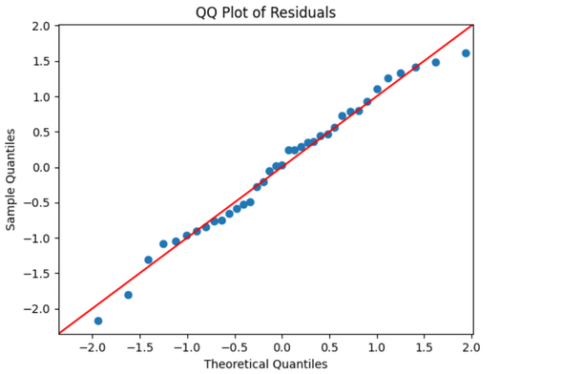
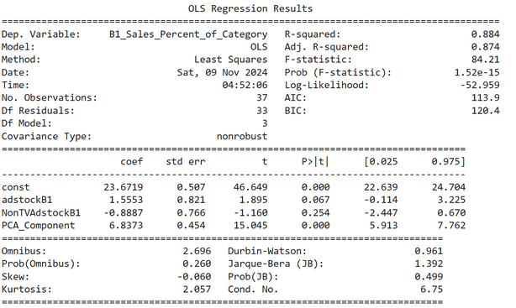

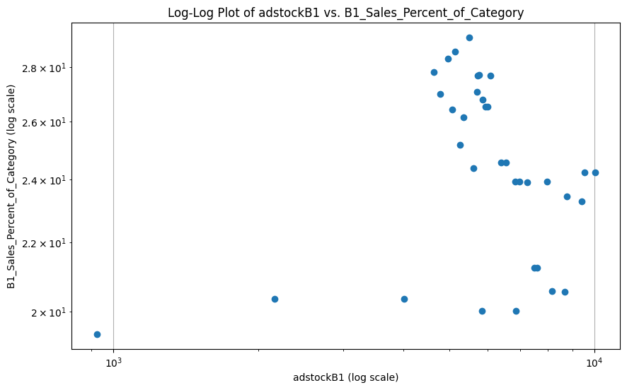
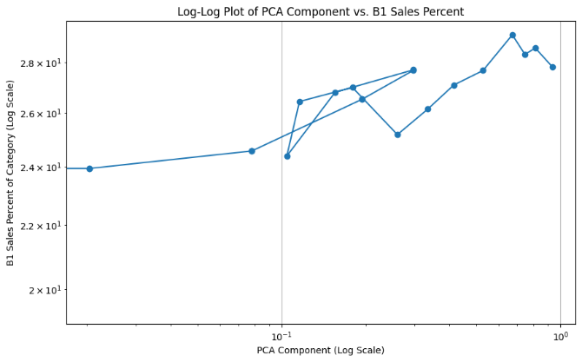

MODEL REFRENCE:
Data Cleaning:
Removed blank columns Competition Normalised GRP's (30 seconds)- C3 C4 C5 C6 C7
Competition Absolute Media Spends Non TV (Incl. Print / Outdoor etc) - C2 C3 C4 C5 C6 C7
TP2
Imputed missing values for B1 Absolute Media Spends Non TV Print and NON TV C1 with a combination of linear regression and KNN algorithm. Coding file:

